Slide 1

GOOGLE
MERCHANDISE STORE

Slide 2

ABOUT GOOGLE ANALYTICS
Google Analytics is a web analytics service offered by Google that tracks and reports traffic, currently as a platform inside the Google Marketing Platform brand. Google launched the service in November 2005 after acquiring Urchin.

Slide 3
EVOLUTION OF GOOGLE ANALYTICS TRACKING
2005
2007
2009
2014
Google uses acquisition of Urchin Sofware to power Google Analytics
Custom event tracking
Faster and more accurate
UID
Enhanced eComm
1
2
3
4
And still counting!

Slide 4

01
02
PROBLEM STATEMENT
EXPLORATORY DATA ANALYSIS
03
04
MODELLING
SCORING
05
CONCLUSION
What are we trying to predict
What are the sources of traffic
F1, Accuracy and AUC

Slide 5
Problem Statement
The 80/20 rule has proven true for many businesses–only a small percentage of customers produce most of the revenue. As such, marketing teams are challenged to make appropriate investments in promotional strategies. For this project,we are challenged to analyze a Google Merchandise Store (also known as GStore, where Google swag is sold) customer dataset and identify the best model to predict the probability of a session being revenue-generating.
The f1-score, accuracy and auc score from different machine-learning models will be compared and used to evaluate the best model for prediction.

Slide 6
DataSet
Data Shape
903,653 rows, 12 columns
Data Type Issue
includes JSON columns which required flattening
Final Data Shape
903,653 rows, 55 columns
GASP!!
That is a huge dataset!

Slide 7
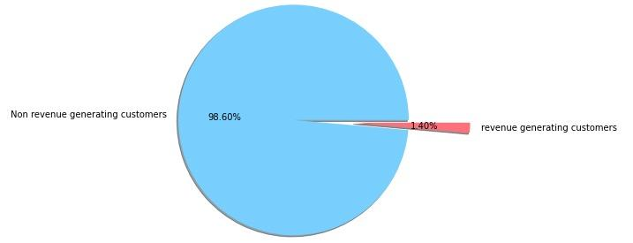
Revenue Generating Customers
Customers
Non-revenue customers:
704,171
Revenue-generating customers:
9996
Percentage
1.3997%

Slide 8
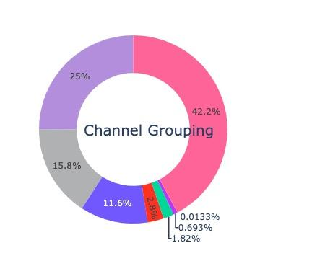
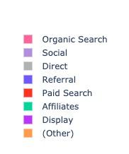
Channel Grouping
3) Direct
Refers to traffic by typing the URL into the browser or through bookmarks
1) Organic Search
Based on unpaid ranking. Accounts for the highest visits to the website
2) Social
Refers to traffic from social networks and social media platforms

Slide 9
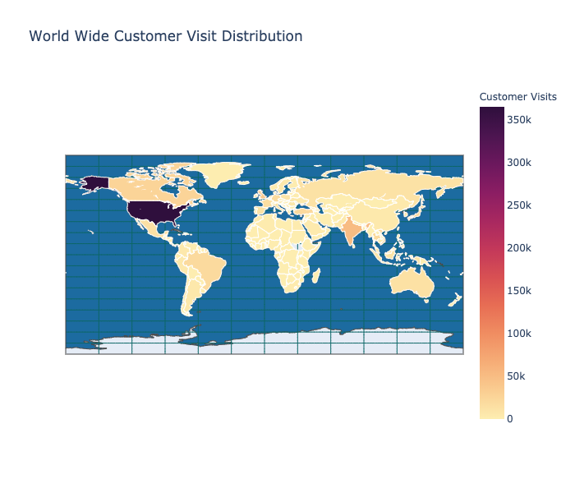
Customer Visits Distribution
1) United States
3) United Kingdom
2) India

Slide 10
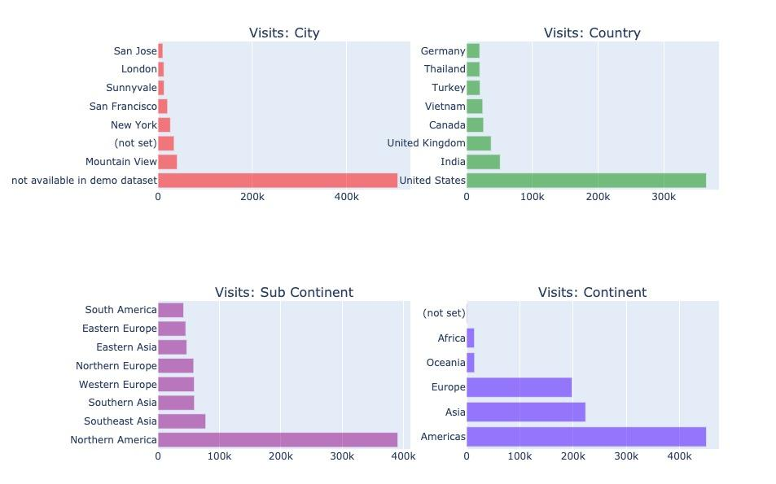
Customer Visits Distribution

Slide 11
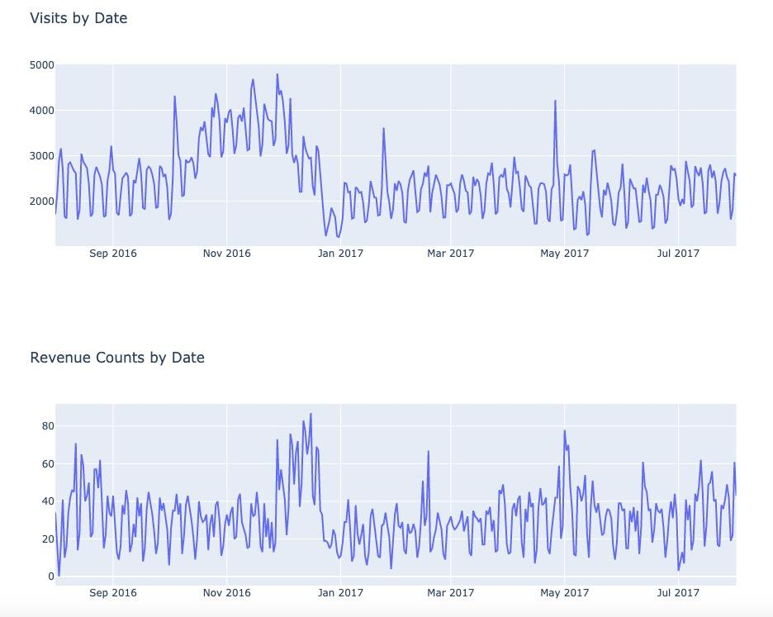
Visits and Revenue by Date

Slide 12
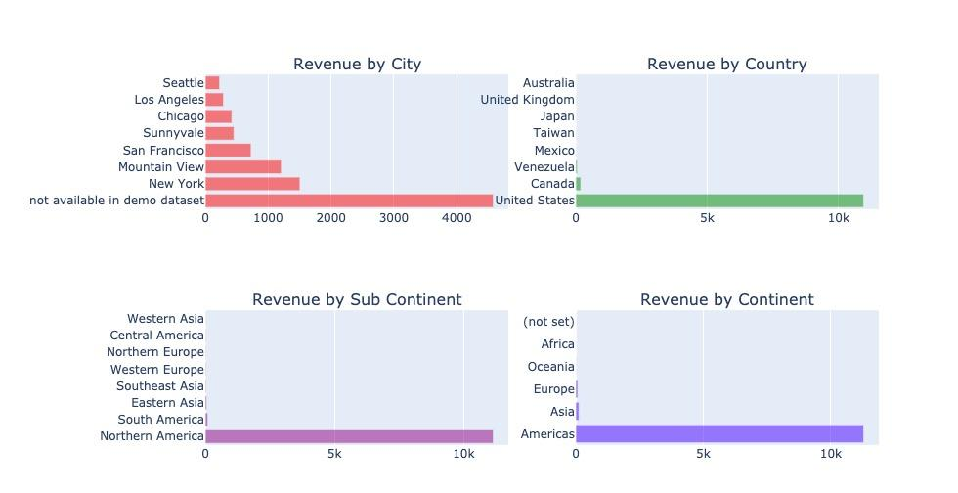
Revenue Sources

Slide 13
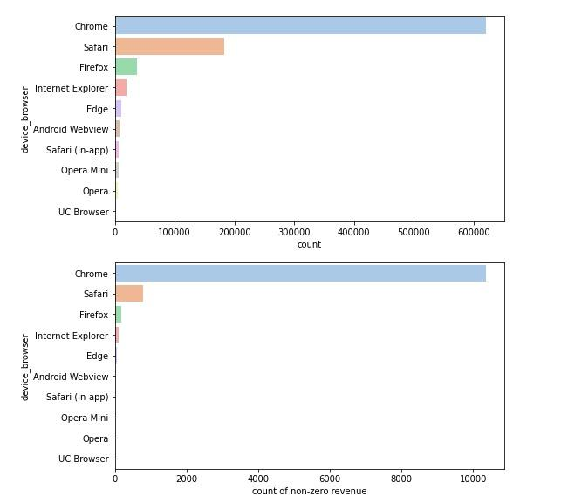
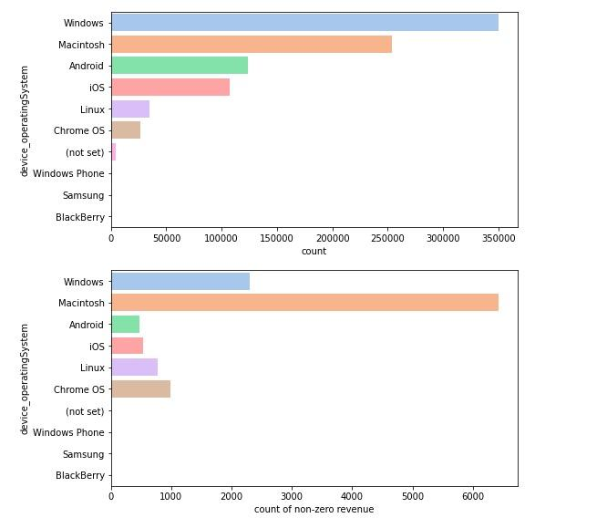
Browser and Operating System

Slide 14
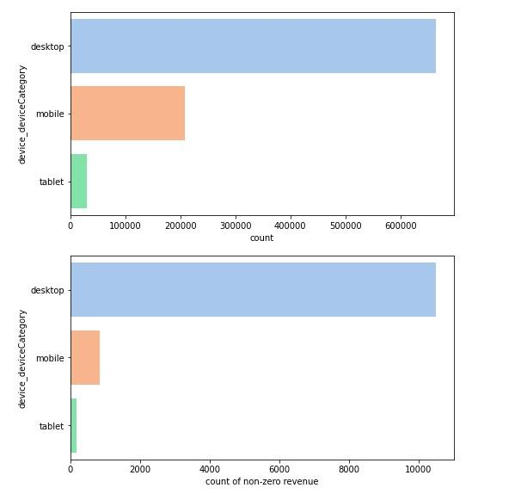
Device Categories

Slide 15
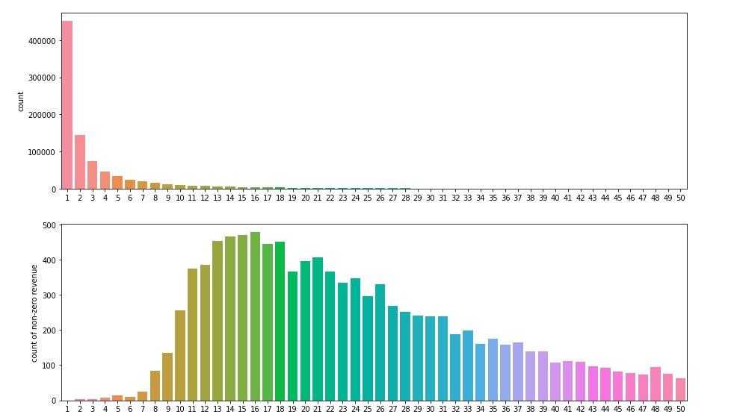
Totals PageViews

Slide 16
Data Cleaning and PreProcessing
Columns with 1 value and too many missing values are dropped
Identify Outliers
One Hot Encoding on categorical features

Slide 17
Modelling
Logistic Regression
Extra Trees
Gradient Boosting
Target Variable is Binary
Ensemble learning technique and predictions are made by using majority voting
Trains many models in a gradual, additive and sequential method

Slide 18
Model Scores
F1 Scores
Test Accuracy
Auc score
LogReg
0.623775
0.969547
0.760835
LogReg Filtered
0.566162
0.966204
0.727228
LogReg GridSearch
0.567107
0.966268
0.727689
ExtraTrees
0.444305
0.962046
0.656424
Extra Trees Filtered
0.558448
0.962925
0.739401
ExtraTrees GridSearch
0.00000
0.952381
0.50000
Gradient Boosting GridSearch
0.634515
0.966868
0.794487

Slide 19
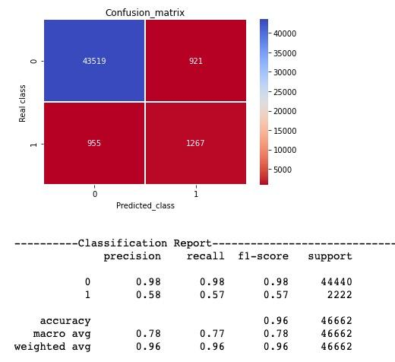
Best Model -Gradient Boosting
Confusion Matrix

Slide 20
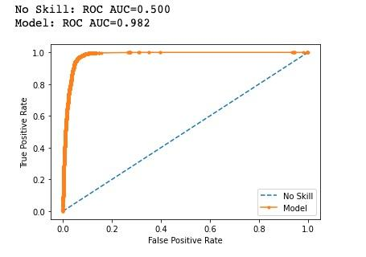
Best Model Performance - ROC-AUC Curve

Slide 21
Conclusion
Logistic Regression, Extra Trees and Gradient Boosting models are used to model the data. There is a heavy class-imbalance in the data, at 100:1 ratio of non-revenue generating against revenue generating sessions. Random UnderSampler was used to adjust for the imbalance.
Gradient Boosting has shown to be the best performing model at an overall accuracy of 96.7%,with f1 score and auc scores of 63% and 79% respectively. ROC-AUC score achieved 98% using this method.
The test recall score works out to be 60% which is expectedly lower due to the highly imbalanced data and by using random undersampling, all of the training data points from the minority class (revenue generating) are used but instances are randomly removed from the majority training set till the desired balance is achieved which in this case the ratio applied was 1:20. One disadvantage of this approach is that some useful information might be lost from the majority class due to the undersampling.

Slide 22
Future Considerations
One future consideration is to use undersampling methods in conjunction with an oversampling technique for the minority class, which may result in better performance than using oversampling or undersampling alone on the training dataset
For the next iteration, the classifier model should be applied on unseen data to validate the scoring.

Slide 23

THANKS
Does anyone have any questions?
Presenter: Emily Kong

